Slide 1

NATIONAL EDUCATION SOCIETY JNN College Of Engineering Shivamogga Department Of Information Science And Engineering TITLE: INSURANCE PRICING FORECAST
Presented by,
Amulya N Dummer 4JN23IS010
Anu H S 4JN23IS013
Deeksha U Harige 4JN23IS030
Deekshitha G Naik 4JN23IS031

Slide 2
Insurance Pricing Forecast:
Insurance Pricing Forecast is a machine learning–based process of predicting insurance premium costs by analyzing historical data, risk factors, and hidden patterns to estimate accurate future pricing.
Need for Insurance Pricing Forecast:
To predict accurate insurance premiums based on risk factors.
To improve pricing decisions and reduce manual errors.
To maintain a balance between risk coverage and profitability.
To analyze historical data and identify hidden patterns affecting insurance costs.
To help insurers provide fair, efficient, and personalized pricing for customers.

Slide 3
Problem statement
Insurance companies face significant challenges in determining accurate and fair premium pricing due to the complexity and variability of risk factors involved. Traditional pricing methods rely on manual calculations and statistical assumptions, which are often insufficient to handle large volumes of data and fail to capture complex, non-linear relationships between variables such as age, BMI, lifestyle habits, and medical history. These limitations can lead to inaccurate pricing, lack of personalization, and increased chances of human error. Therefore, there is a need to develop an efficient and automated system that leverages techniques from Machine Learning to analyze historical data, identify hidden patterns, and predict insurance premiums accurately, ensuring improved decision-making, scalability, and fairness in pricing.

Slide 4
Objectives
The main objectives of developing an Insurance Pricing Forecast are:
To develop a machine learning model for predicting insurance premiums
To analyze the impact of various features (age, BMI, smoking habits, etc.)
To improve prediction accuracy using data-driven techniques
To automate the insurance pricing process
To gain practical experience in machine learning model development
Applications
Personalized Premium Calculation: Calculates insurance cost based on individual risk factors
Risk Assessment: Helps identify high-risk and low-risk customers
Automated Pricing: Reduces manual effort and improves efficiency
Fraud Detection: Identifies unusual or suspicious patterns
Customer Segmentation: Groups users for better policy design
Real-Time Prediction: Provides instant premium estimates in web apps
Policy Optimization: Helps companies design better pricing strategies

Slide 5
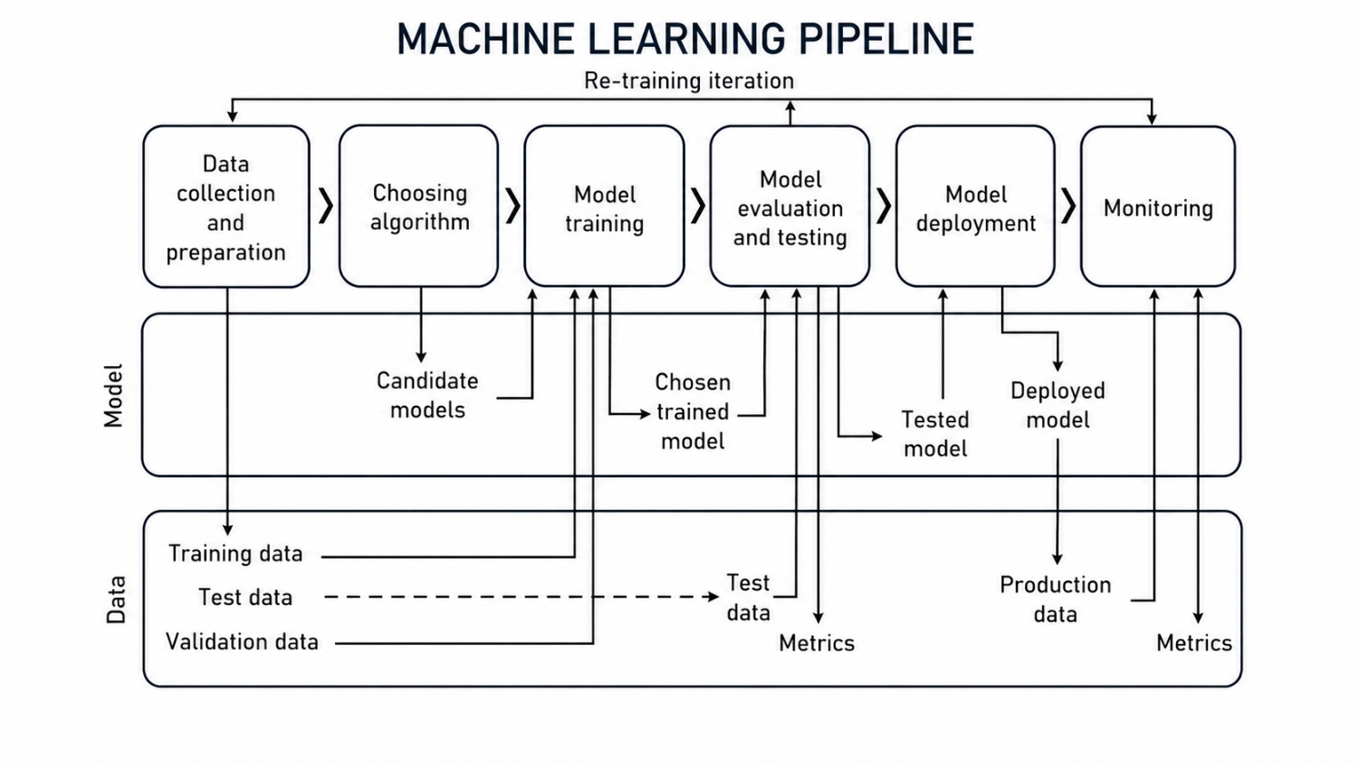
Flow chart:

Slide 6
1. Data Collection and Preparation
This is the starting point of the pipeline.
Data is collected from sources like datasets, APIs, or databases.
Then it is cleaned and prepared:
Handling missing values
Removing duplicates
Encoding categorical data
Normalization/standardization
Output: Clean dataset ready for modelling
2. Choosing Algorithm
Different algorithms are selected based on the problem type:
Regression (for price prediction)
Classification (for categories)
Multiple models are tested (called candidate models)
Examples:
Linear Regression
Random Forest
Gradient Boosting

Slide 7
3. Model Training
The selected algorithms are trained using training data
The model learns patterns between input (features) and output (target)
Important:
Training data = data used to teach the model
The model adjusts its internal parameters
Output: Trained model
4. Model Evaluation and Testing
The trained model is tested using:
Validation data (for tuning)
Test data (for final evaluation)
Performance is measured using metrics:
MAE (Mean Absolute Error)
MSE (Mean Squared Error)
R² Score
Output: Tested model + performance metrics

Slide 8
5. Model Deployment
Once the model performs well, it is deployed into a real system
It can be integrated into:
Web applications
Mobile apps
APIs
Now the model starts working on real-world (production) data
6. Monitoring
After deployment, the model is continuously monitored:
Accuracy over time
Data changes
Errors or failures
Real-world data changes → model performance may drop

Slide 9
7. Re-Training Iteration (Very Important)
If performance decreases:
New data is collected
Model is retrained
This creates a continuous learning loop

Slide 10
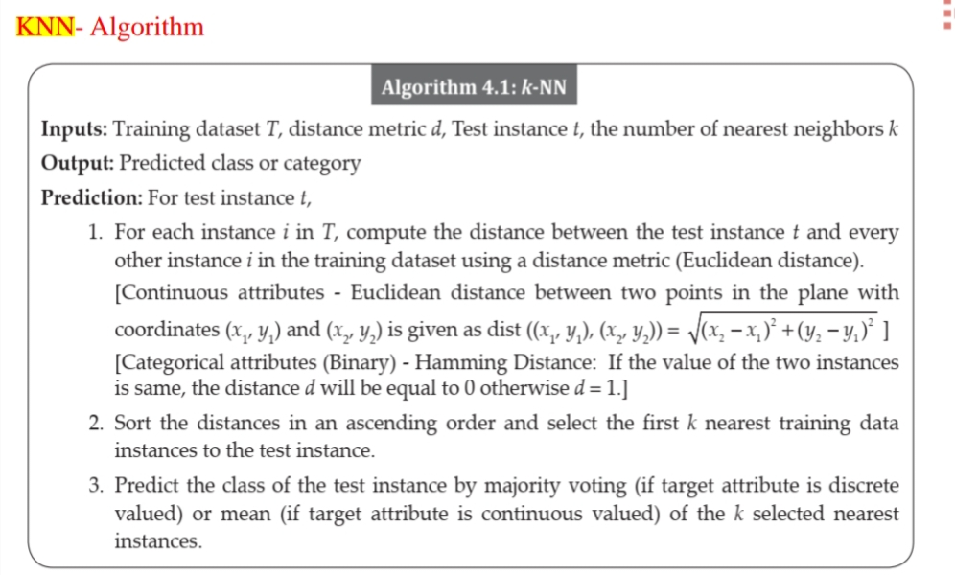

Slide 11
Gradient Boosting Algorithm:
Gradient Boosting is a powerful ensemble machine learning algorithm that builds models sequentially, each correcting the errors of the previous one, using gradient descent to minimize a chosen loss function. It is widely used for regression, classification, and ranking tasks due to its high accuracy and flexibility.
How Gradient Boosting Works?
Initialize Model - Start with a simple model (often a constant prediction like the mean of the target values).
Compute Residuals - Calculate the errors (residuals) between predictions and actual values.
Fit Weak Learner - Train a weak learner (commonly a decision tree) to predict these residuals.
4. Update Model - Add the new learner’s predictions to the ensemble, scaled by a learning rate (η).
Repeat Iteratively - Continue building new learners, each correcting the mistakes of the ensemble so far, until a stopping criterion (like max iterations or minimal improvement) is reached.

Slide 12
Algorithm Steps (Simplified Pseudocode)
Text
Input: Training data (X, y), number of iterations M, learning rate ηInitialize model F0(x) = mean(y)
For m = 1 to M:
Compute residuals: ri = -∂L(yi, F(xi)) / ∂F(xi)
Fit weak learner hm(x) to predict residuals ri
Update model: Fm(x) = F{m-1}(x) + η * h_m(x)
Output: Final model F_M(x)`
L = loss function (e.g., mean squared error for regression, log-loss for classification).
η (learning rate) controls contribution of each learner (small η → more trees, less overfitting).

Slide 13
Advantages:
Accuracy – Predicts premiums using data‑driven machine learning models.
Efficiency – Automates pricing, reducing manual workload.
Personalization – Tailors premiums to individual risk profiles.
Scalability – Handles large datasets and multiple customer segments.
Decision Support – Helps insurers set fair and competitive prices.
Disadvantages:
Data Dependency – Requires high‑quality, complete data for reliable results.
2. Complexity – Model training and tuning need technical expertise.
3. Cost – Implementation and maintenance can be expensive.
4. Privacy Risks – Sensitive customer data must be securely managed.
5. Bias Potential – Inaccurate or biased data can lead to unfair pricing.

Slide 14
Real World Examples:
Progressive (USA): Uses ML in its Snapshot program to set auto premiums based on driver behavior.
Allianz (Global): Applies predictive analytics for health and life insurance pricing.
AXA (Europe): Employs AI to forecast claims and adjust premiums dynamically.
LIC (India): Integrates demographic and medical data for life insurance premium calculations.
Conclusion:
Insurance Pricing Forecast systems transform traditional premium calculation by leveraging data analytics and machine learning. They ensure accurate, fair, and personalized pricing while improving efficiency and competitiveness. By combining customer data with predictive models, insurers can build trust, optimize operations, and deliver smarter, customer‑centric solutions.

Slide 15
THANK YOU

